Slide 1
Analyzing Loan Performance: The Impact of Loan Rank and Credit Score
Presented by
Akshay Bollam

Slide 2
Problem Statement: Analyzing Loan Default Risk
Objective:
This project aims to analyze user performance in terms of loan repayment by examining loan rank and credit score. The primary focus is to evaluate whether users defaulted on their loans or repaid them on time, using key metrics like:
Key Metrics:
Loan Rank: Users are ranked based on their borrowing behavior, which influences default risk.
Credit Score: A key factor in determining a user's ability to repay loans.
Loan Repayment Status: Identifying users who defaulted (didn’t repay even 90 days after the due date) versus those who repaid on time.
Goal:
The goal is to uncover patterns and trends that can help predict loan default and inform risk assessment for future loans.

Slide 3
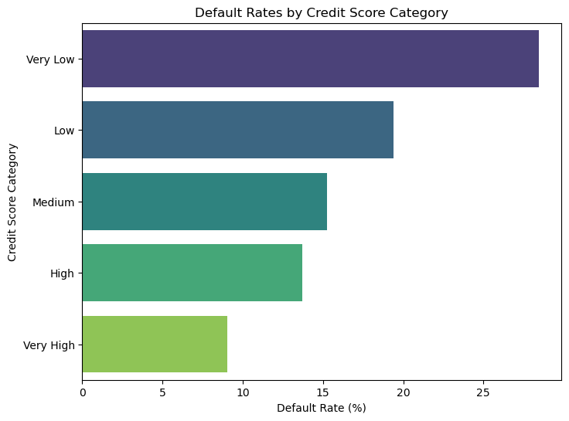
Default Rates Across Credit Score Categories
The analysis shows that users with lower credit scores (e.g., 'Very Low' and 'Low') tend to have higher default rates compared to those with higher credit scores.
The default rate decreases as the credit score improves, with 'Very High' credit score category showing the lowest default rate.
This suggests that users with lower credit scores may pose higher risks for lenders, while those with higher credit scores are more likely to repay their loans on time.

Slide 4
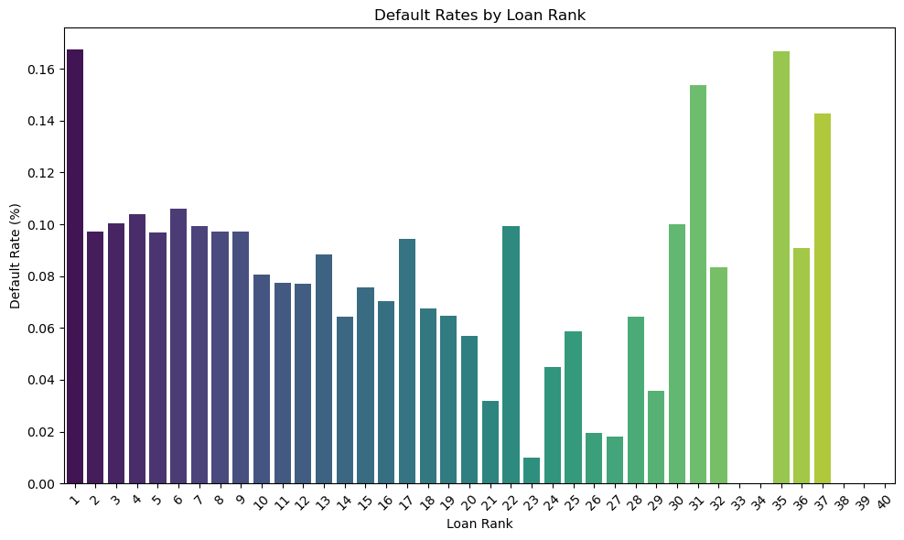
Default Rates by Loan Rank
The default rate varies by Loan Rank, with higher Loan Ranks showing different repayment behavior.
The chart shows default rates for Loan Ranks up to 40, providing insight into how default rates change as users take out more loans.
This analysis could suggest that as users progress through more loans (higher Loan Ranks), the likelihood of default may either increase or decrease, depending on trends in the data.

Slide 5
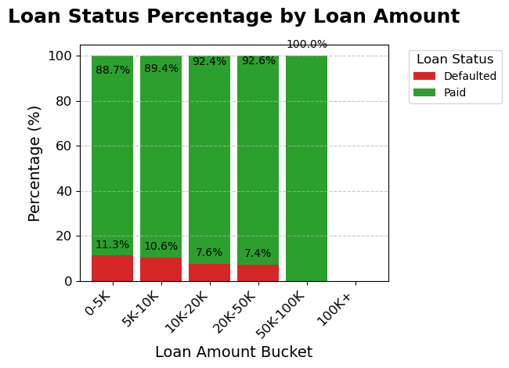
Loan Status Distribution by Loan Amount
Loans in the 0-5K and 5K-10K ranges exhibit similar default rates, indicating that slightly higher loan amounts do not necessarily reduce the risk of default for these borrowers.
Despite the increased loan amount from 0-5K to 5K-10K, the default rates remain similar, suggesting that factors other than loan size may influence repayment behavior in these categories.
The comparable default rates for loans between 0-10K imply that additional loan amount does not substantially improve repayment stability, highlighting the need to assess other borrower characteristics.

Slide 6
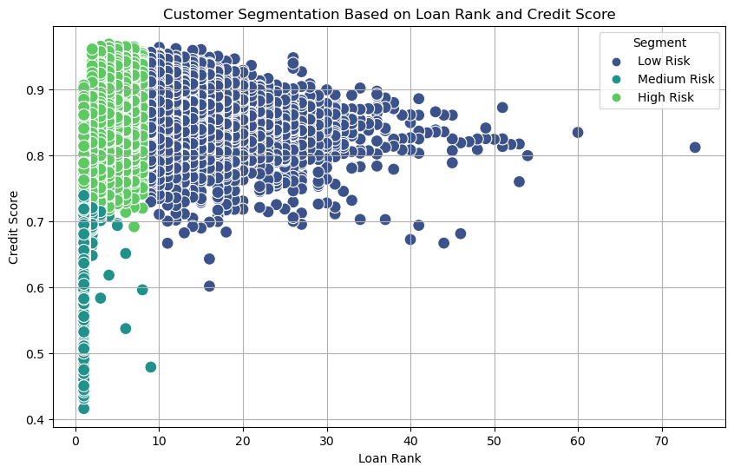
Customer Segmentation Based on Loan Rank and Credit Score
High Risk Segment: Customers with a loan rank below 10 fall under the high-risk category, despite having above-average credit scores.
Low Risk Segment: Customers with higher loan ranks (above 20) are categorized as low risk, typically having lower credit scores but posing minimal default risk.
Loan rank is a more significant indicator of risk than credit score, emphasizing the need for lenders to prioritize rank in risk evaluation.

Slide 7
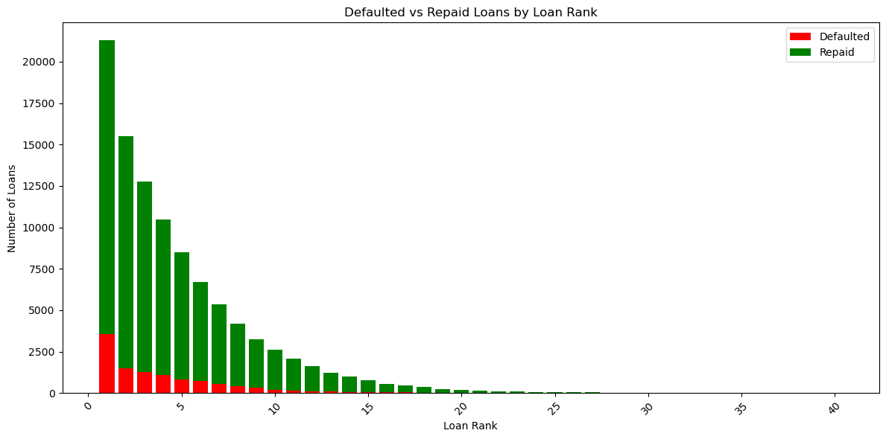
Analysis of Loan Default and Repayment by Loan Rank
Loan Rank Impact on Defaults: Loans with lower ranks (higher risk) have a significantly higher number of defaults compared to loans with higher ranks.
Repaid Loans Dominate: Despite higher defaults in low ranks, most loans across all ranks are successfully repaid, particularly as loan rank increases (lower risk).
Borrowers with lower ranks are more prone to default, highlighting the need for targeted interventions or stricter credit policies in high-risk segments.

Slide 8
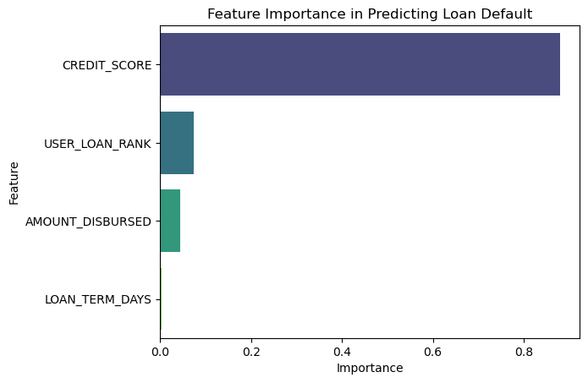
Key Factors Influencing Loan Default Prediction
CREDIT_SCORE is the most significant factor in predicting loan defaults, indicating that borrowers with lower credit scores are at a higher risk of defaulting.
USER_LOAN_RANK and AMOUNT_DISBURSED have a moderate impact on defaults, implying that higher-risk ranks and larger loan amounts slightly increase the likelihood of defaults.
Interpretation: The prominent role of CREDIT_SCORE emphasizes its importance for lending companies in evaluating loan risk, suggesting they should prioritize credit score assessments to improve risk management and enhance loan approval decisions.

Slide 9
Conclusion
Credit Score is the primary predictor of loan defaults, with lower scores strongly correlating to higher default rates, indicating a higher risk for lenders.
Loan Rank also influences default rates, where borrowers with higher loan ranks tend to have slightly increased default probabilities, suggesting potential risk factors related to loan size.
Customer Segmentation based on loan rank and credit score allows for better risk identification, enabling lenders to classify borrowers into high, medium, or low-risk categories.
Key Factors, especially credit score and loan rank, should be prioritized in loan assessment processes, enhancing the accuracy of default predictions and improving overall risk management strategies.

Slide 10
Thank You

